Slide 1

Travel APP
A travel application is a software platform designed to assist users in planning, organizing, and enhancing their travel experiences. Here is a short point-by-point description of the key features and functionalities typically found in a travel application.
~Sandeep Subbiah Selvakumar

Slide 2
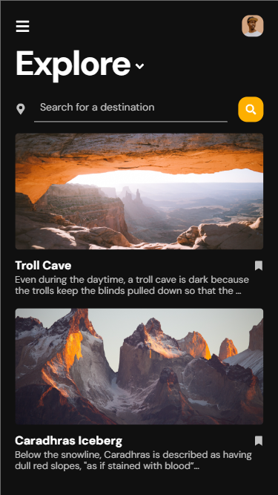
Home
User Profile Creation: Users can create personal profiles, including preferences, travel history, and contact information.
Search and Booking: Users can search for flights, hotels, rental cars, and other travel services based on their destination, dates, and budget. They can also make bookings directly through the app.
Itinerary Planning: Users can create, customize, and manage their travel itineraries, including adding activities, attractions, and restaurant reservations.
Real-Time Alerts: The app provides real-time updates on flight delays, gate changes, and other travel-related notifications.
Maps and Navigation: Integrated maps with GPS functionality help users navigate their destination, locate points of interest, and get directions.
Reviews and Ratings: Access to user-generated reviews and ratings for hotels, restaurants, and attractions helps users make informed decisions.
Local Recommendations: The app suggests local experiences, hidden gems, and popular places based on user preferences and location.
Travel Documents and Reminders: Users can store digital copies of passports, tickets, and other important documents. The app can also send reminders for visa renewals, flight check-ins, and more.
Social Sharing: Share travel plans, photos, and experiences with friends and family through social media integration.
Feedback and Support: Provide feedback, contact customer support, or report issues directly through the app.
Travel Journal: Some apps offer the option to create a digital travel journal to document memories and share them with others.

Slide 3
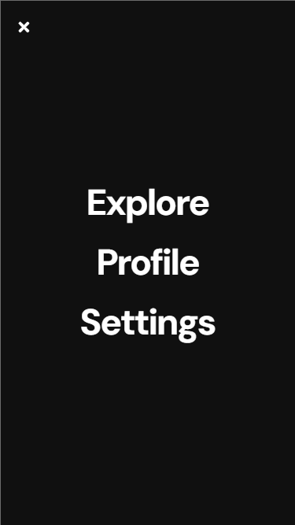
Menu
More broadly, a list of choices available for selection in various contexts, such as a menu of options, travel destinations, user profile and preference.

Slide 4
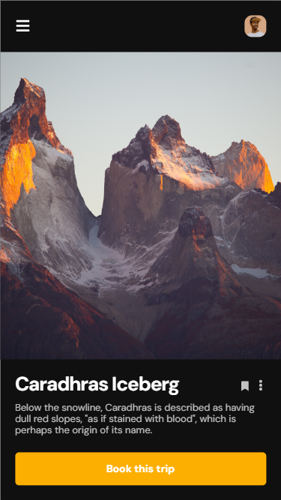
Trip Details
Activity to view the selected list of grid navigating to the travel location.
Representing with image view with heading following the description.
Also, user will be able to book for the trip.

Slide 5
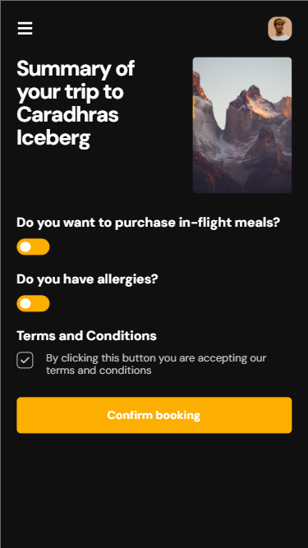
Trip Summary
A trip summary is a concise and organized overview of a travel experience with Trip Details, Itinerary, Accommodations, Transportation, Sightseeing, & Activities, Cuisine and Dining, Weather, Budget, Memorable Moments and Photos & Souvenirs.

Slide 6
Technical Specification
Programming Languages: Java
Databases: SQLite and Firebase
Software Development Kit: Android Studio Version 4
Target Version: Android 7.0
Design Patterns: A mixture of Model view Presenter(MVP), Model View ViewModel (MVVM), Factory Design Pattern etc.,

Slide 7
Technical Design
1. Mobile Application:
Platform: Android and iOS.
Development Framework: Use a cross-platform development framework like React Native or Flutter for code reusability and faster development.
2. Backend Services:
Server: Set up a backend server to handle data storage, authentication, and communication with external APIs.
Database: Use a relational database (e.g., PostgreSQL, MySQL) or a NoSQL database (e.g., MongoDB) to store user data, destination details, and other app-related information.
APIs: Develop RESTful APIs to serve data to the mobile app and integrate with third-party services (e.g., weather APIs, currency conversion APIs).
3. User Authentication:
Implement user authentication and authorization mechanisms for secure access to user-specific data and features.
Consider using OAuth 2.0 or JWT (JSON Web Tokens) for authentication.
4. Frontend Components:
User Interface (UI): Design an intuitive and user-friendly UI following Material Design or Human Interface Guidelines.
Navigation: Implement navigation between screens and tabs to ensure smooth user flow.
Search Bar: Include a search bar for users to enter their desired travel destinations.
Homepage: Display popular destinations, featured travel packages, and quick access to search.
Destination Details Page: Provide detailed information about each destination, including attractions, cuisine, and a map.
Favorites Page: Allow users to manage and access their saved favorite destinations.
Settings Page: Let users configure app settings, including language and currency preferences.
Feedback and Support: Include a section for users to submit feedback or seek assistance.
5. External Integrations:
Weather API: Integrate with a weather service (e.g., OpenWeatherMap) to fetch real-time weather data for selected destinations.
Currency Conversion API: Incorporate a currency conversion service (e.g., Fixer.io) for currency conversion functionality.
Maps and Location Services: Utilize maps and location services (e.g., Google Maps) for displaying maps and finding nearby attractions.
6. Offline Access:
Implement local storage mechanisms to provide limited offline access to saved destinations and basic destination information.
7. Third-Party Libraries and Tools:
Utilize libraries and tools for tasks such as UI components (e.g., Material-UI for React Native), state management (e.g., Redux), and HTTP requests (e.g., Axios).
8. Testing and Quality Assurance:
Conduct unit testing and integration testing to ensure the app's functionality and stability.
Implement continuous integration (CI) and continuous deployment (CD) pipelines for automated testing and deployment.
9. Scalability and Performance:
Design the architecture to be scalable, allowing for an increase in users and data without compromising performance.
Optimize API calls, database queries, and image loading for efficiency.
10. Security:
Implement security measures, including data encryption, input validation, and secure storage of user credentials.
Regularly update and patch software components to address security vulnerabilities.
11. Monitoring and Analytics:
Integrate monitoring and analytics tools to track user behavior, app performance, and potential issues.
12. Deployment:
Deploy the mobile app to Google Play Store for Android and Apple App Store for iOS.
Deploy the backend on a cloud hosting platform like AWS, Azure, or Google Cloud.
13. Maintenance and Updates:
Plan for regular app updates, bug fixes, and feature enhancements based on user feedback and changing requirements.

Slide 8
Detailed Application Functionalities
Platform and Compatibility:
The app will be developed for the Android operating system, targeting a minimum Android version of 7.0 (Nougat) to maximize compatibility.
Homepage:
Implement a user-friendly and responsive homepage.
Include a search bar at the top of the homepage for entering travel destinations.
Below the search bar, include a "Popular Destinations" section with sample destinations for quick inspiration.
Search Functionality:
Implement a search feature that allows users to input a destination and initiate a search.
Develop a search results page that displays basic details of the destination, including the current weather, a brief description, and an image.
Enable users to tap on a destination in the search results to access more detailed information.
Destination Details:
Create a destination details page that provides in-depth information about the selected location.
Include sections for top attractions, local cuisine, and a map with key points of interest.
Weather Information:
Integrate a weather API to provide real-time weather conditions and a short-term forecast for the selected destination.
Display weather information on the destination details page.
Save Favorites:
Enable users to mark destinations as "favorites" for easy access in the future.
Provide a dedicated section or page where users can view and manage their favorite destinations.
Basic Settings:
Create a settings page where users can select their preferred language (if available) and set their home currency for the currency conversion tool.
Offline Access:
Implement limited offline functionality, allowing users to access their saved favorite destinations and basic destination information even without an internet connection.
Help and Support:
Develop a section within the app that provides basic FAQs and contact information for customer support.
Feedback and Improvement:
Include a feedback mechanism that encourages users to provide feedback or report issues within the app.

Slide 9
Use CASE FLOW
Search for Destination Use Case:
Actor: Traveler
Description: The traveler searches for a destination.
Trigger: Traveler enters a destination in the search bar and taps the search button.
Basic Flow:
Traveler enters a destination.
App displays search results with destination options.
Traveler selects a destination from the results.
App shows destination details.
View Popular Destinations Use Case:
Actor: Traveler
Description: The traveler views a list of popular destinations.
Trigger: Traveler opens the app or visits the homepage.
Basic Flow:
App displays a list of popular destinations on the homepage.
View Destination Details Use Case:
Actor: Traveler
Description: The traveler views detailed information about a selected destination.
Trigger: Traveler selects a destination from the search results or the popular destinations list.
Basic Flow:
Traveler selects a destination.
App displays detailed information about the selected destination, including attractions, cuisine, and a map.
Check Weather Use Case:
Actor: Traveler
Description: The traveler checks the weather for a specific destination.
Trigger: Traveler views the destination details or uses a dedicated weather feature.
Basic Flow:
Traveler navigates to the destination details.
App displays current weather conditions and a short-term forecast for the selected destination.
Currency Conversion Use Case:
Actor: Traveler
Description: The traveler performs currency conversion.
Trigger: Traveler uses the currency conversion tool.
Basic Flow:
Traveler enters an amount in their home currency.
Traveler selects the destination currency.
App calculates and displays the converted amount.
Save Favorite Destination Use Case:
Actor: Traveler
Description: The traveler saves a destination as a favorite for future reference.
Trigger: Traveler selects the "Save as Favorite" option.
Basic Flow:
Traveler marks a destination as a favorite.
App adds the destination to the user's list of favorites.
Access Saved Favorites Use Case:
Actor: Traveler
Description: The traveler accesses their list of saved favorite destinations.
Trigger: Traveler selects the "Favorites" section in the app.
Basic Flow:
Traveler navigates to the "Favorites" section.
App displays a list of saved favorite destinations.
Configure App Settings Use Case:
Actor: Traveler
Description: The traveler configures app settings, such as language and home currency.
Trigger: Traveler accesses the app settings.
Basic Flow:
Traveler opens the settings menu.
App displays options to set language preferences and home currency.
Provide Feedback Use Case:
Actor: Traveler
Description: The traveler provides feedback or reports issues to the app's support team.
Trigger: Traveler accesses the feedback and support section.
Basic Flow:
Traveler opens the feedback and support section.
App provides options to submit feedback or contact customer support.

Slide 10
Splash Screen Activity
Search Results Activity
Destination Details Activity
Weather Activity
Home Activity
Currency Conversion Activity
Favourites Activity
Feedback Activity
ACTIVITIES

Slide 11
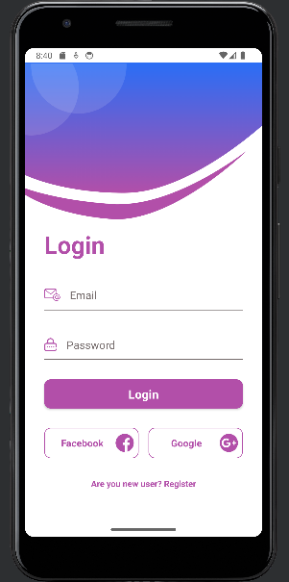
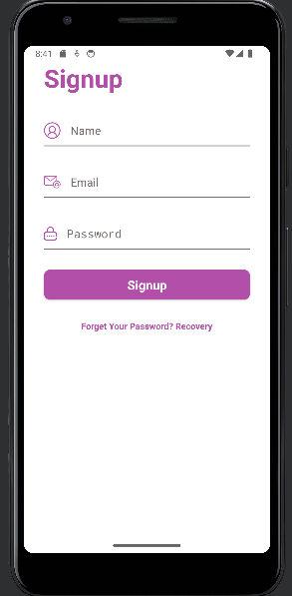
Login, Sign UP and Reset password

Slide 12
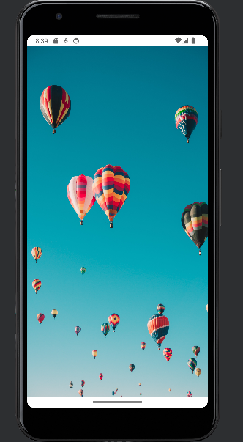

Splash Screen

Slide 13
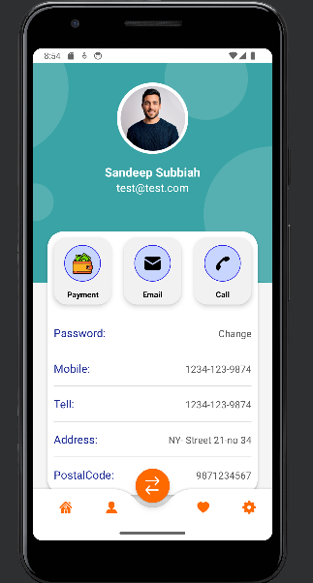
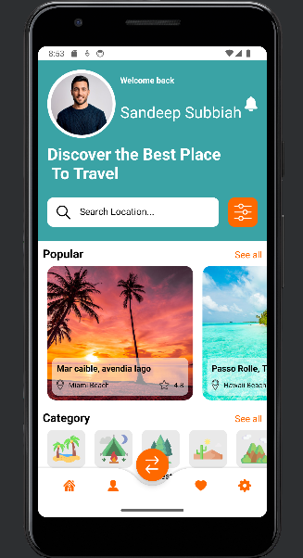
Landing and Setting page

Slide 14
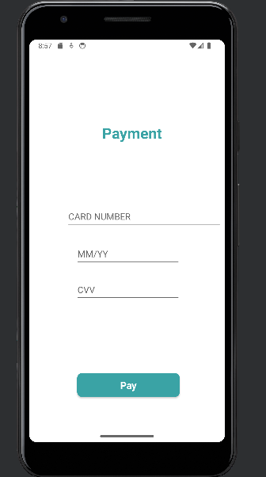
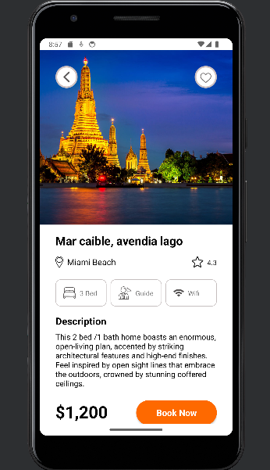
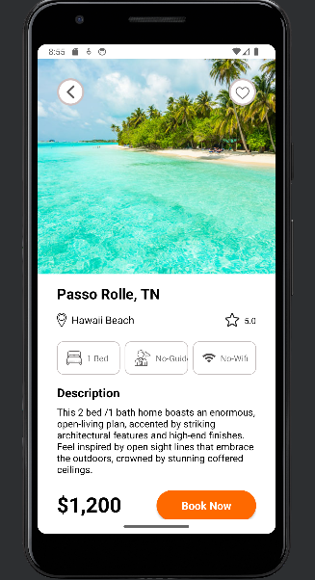
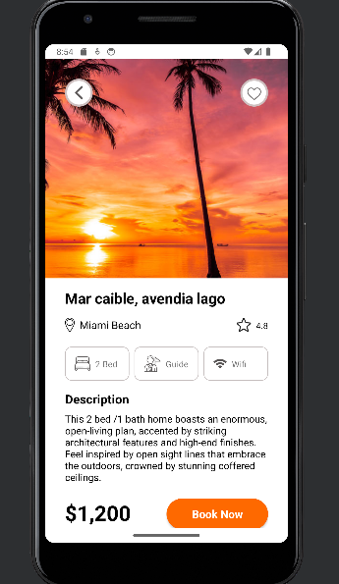
Locations and Payment

